Slide 1



Consultancy Project Jewellery Sales
TEAM NO
19C45
GUIDED BY
DR.K.Nirmala Devi
PRESENTED BY
19CSR117 -NANDHAKUMAR R G
19CSR122 -NIKHALYAA S
19CSR138 -PRANESH V R
DEPARTMENT OF COMPUTER SCIENCE AND ENGINEERING

Slide 2
PROBLEM STATEMENT
Most of the customers are choosing their designs of jewells from the jewellery shops website. But the shop we choose doesn’t have one, And facing trouble reaching new customers.
Ranga Jewellery is a famous best moving shop in vellore which doesn’t have any website to attract customers from other places.
So they have requested us to develop a site for Jewellery Sales.

Slide 3
PROPOSED WORK
In the proposed work , We have decided to develop a website that will showcase their products in various ways. There will be admin panel to manage all the features mainly to add products and maintain them. The page will have separate module to display upcoming products and newly released designs. We will constantly maintain the live gold price in the site.

Slide 4
SOFTWARE REQUIREMENTS SPECIFICATION
Functional Requirements
Display the jewellery designs and various models into the website.
Customers can add custom jewellery images and can request the shop for the availability of that design.
Authentication.
History of customer purchases.
Non-Functional Requirements
Special control for admin panel for maintaining CRUD operations.
Hosting the website to access from anywhere, anytime. With responsiveness in any device.
Processing speed

Slide 5
MODULES OF THE PROJECT
HOME
SHOP
- GOLD
- SILVER
CONTACT
COLLECTIONS
PROFILE
ABOUT US
ADMIN PANEL
LOGIN/SIGN UP
CART

Slide 6
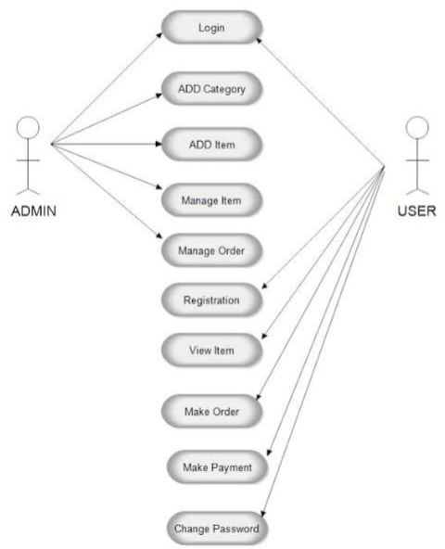
USECASE

Slide 7
TECHNOLOGY USED
We will be using Django technology for implementation.
Software used: Django
Database software: Django Administrator
API: Express.js

Slide 8
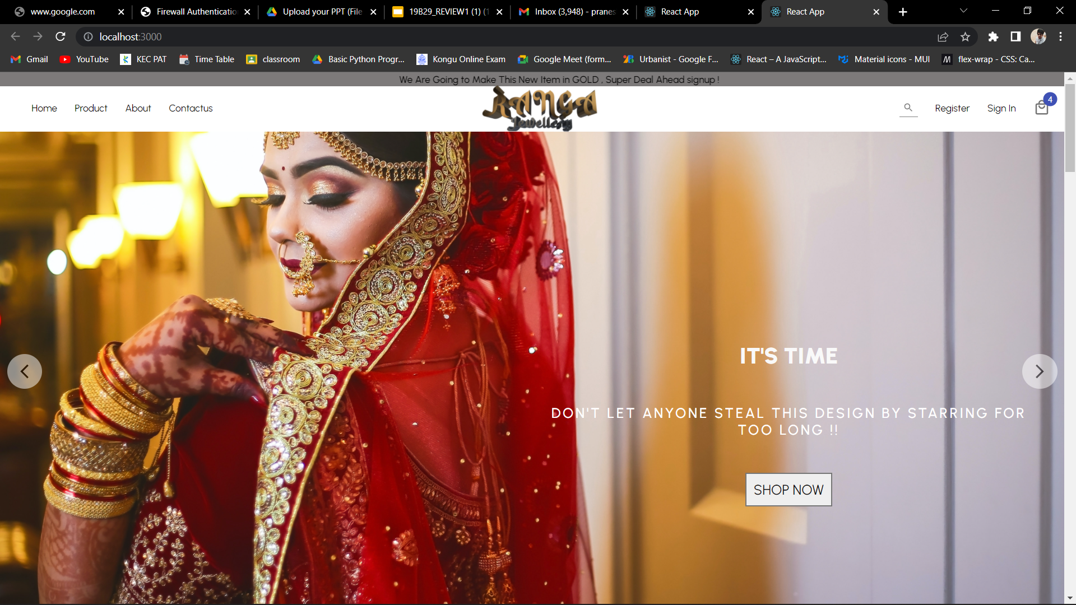

Slide 9
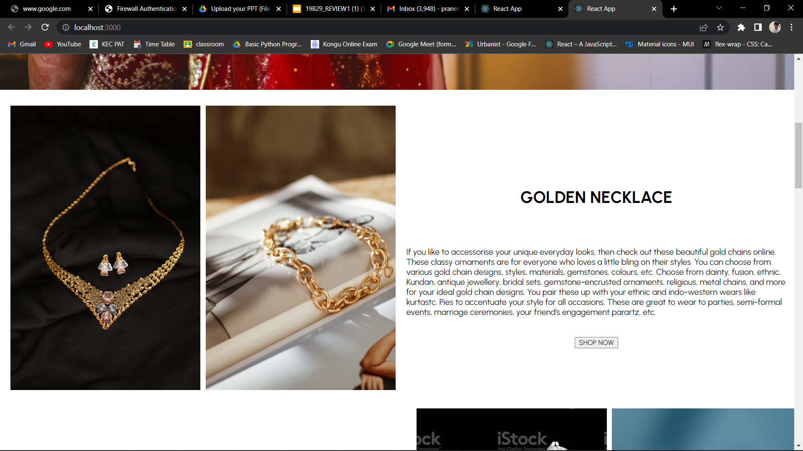
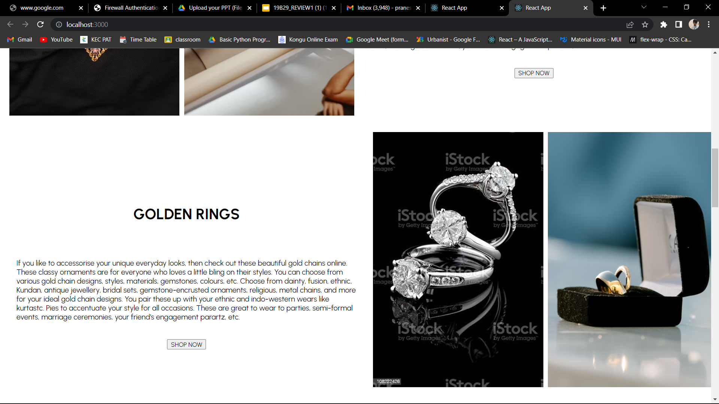

Slide 10
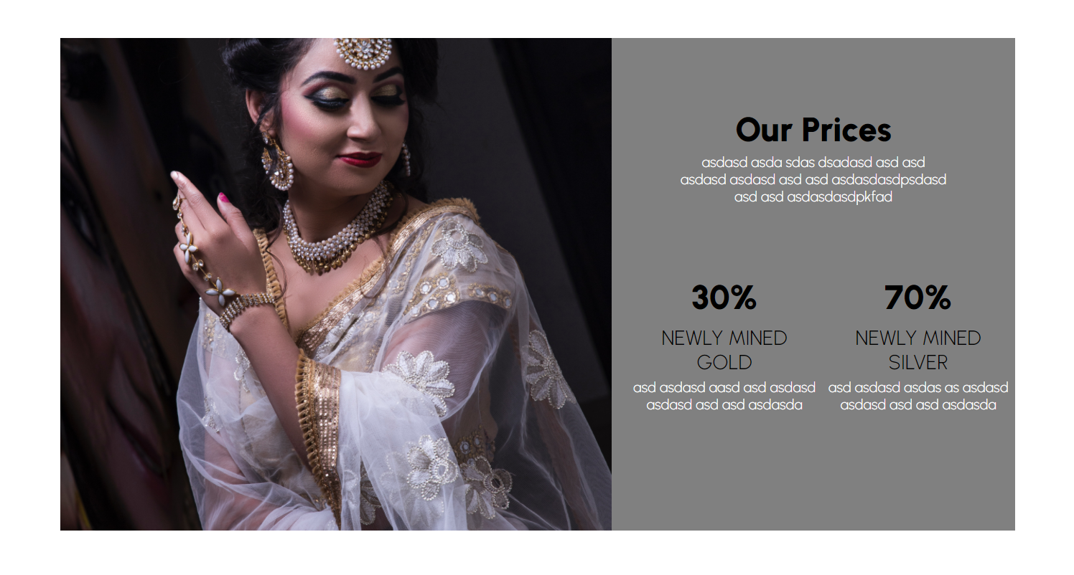
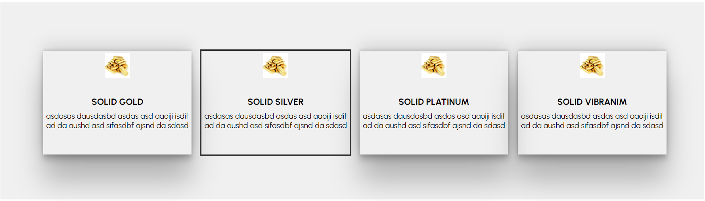

Slide 11
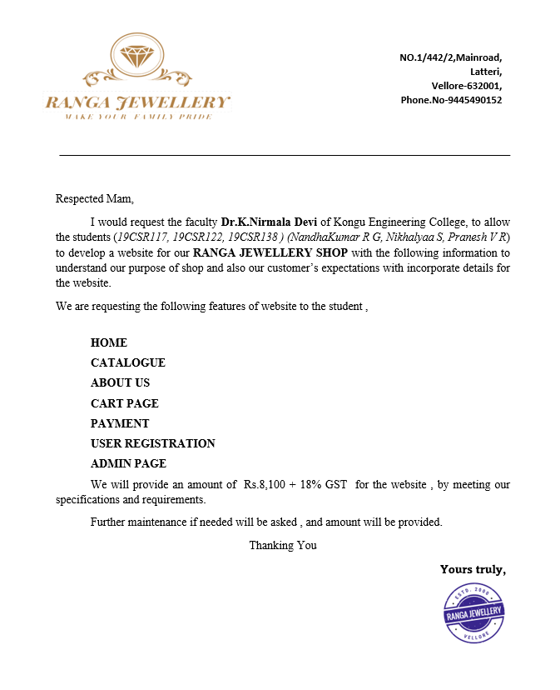
REQUISITION LETTER

Slide 12
THANK YOU!...

